Slide 1
SOFTWARE ENGINEERING
Name: Wenslaus Sifuna Juma Phone: 0745595857
Health Information System (HIS) Intern Project
Project Objective
Develop a basic health information system that enables doctors to:
Create and manage health programs.
Register and manage client profiles.
Enroll clients into programs.
Search for and view client profiles.
Expose client data through APIs.
System Architecture
Frontend: HTML + JAVASCRIPT + CSS
Backend: Python (Flask Framework) Database: MySQL (Accessed via HeidiSQL) API: RESTful Endpoints for client profiles
Key Features
Health Program Management (e.g., TB, HIV, MALARIA)
Client Registration
Client Enrollment into Programs

Slide 2
Client Search and View
API to Expose Client Data
Database Design (HeidiSQL)
Database Setup
Connected to MySQL Server using mysql.connector. Created Database: health_system.
Core Tables
Programs Table:
program_id, program_name, description.
Clients Table:
client_id, first_name, last_name, DOB, gender, phone, email, address.
Enrollments Table:
Manages many-to-many relationships between clients and programs. Foreign keys: client_id, program_id.
Application and Appointment Tables
General Appointments: Name, Email, Created At.
Consultation Appointments: Patient Name, Appointment Details, Department, Doctor.
Volunteer Applications: Volunteer Details, Area of Interest.
Internship Applications: Intern Details, Department.
Job Applications: Applicant Info, Position, Resume File (BLOB).

Slide 3
Patient Management Tables
Patient Registrations: Patient Details and Contact Info.
Patient Admissions: Admission Details, Sickness, Doctor Signature.
Surgery Forms: Surgery Type, Consent, Surgery Date.
Discharge Forms: Treatment Summary, Follow-up Instructions.
Error Handling and Finalization
Used try-except-finally block:
  Catches MySQL connection or query errors.
  Ensures connection closes properly after execution.
BACKEND IMPLEMENTATION
Backend (Python + Flask)
Framework:
  Built using Flask, a lightweight Python web framework ideal for REST APIs.
API Features Developed:
  Create Health Programs: Doctors can add new programs (TB, Malaria, HIV, etc.).
  Register Clients: Add new clients with full personal details.
  Enroll Clients: Enroll clients into one or multiple health programs.
  Search Clients: Find clients easily by name.
  View Client Profiles: Fetch complete client profiles with enrolled programs.
  Appointment and Volunteer Management: Handle general/consultation appointments and volunteer applications.
Integration and Modularity:
  Separate utility functions for database connection management.
  Organized code structure with clear documentation for each API route.
API Exposure:
  Client profiles are exposed via REST API in JSON format for integration with external systems.

Slide 4
Database (MySQL via HeidiSQL)
Database Management:
  Database designed and maintained using HeidiSQL for simplicity and visibility.
Main Tables:
  programs: Stores health program details.
  clients: Holds client personal information.
  enrollments: Many-to-many relationship table between clients and programs.
  general_appointment: Handles general health appointments. o consultation_appointment: Manages consultation bookings. o volunteer_application: Captures volunteer applications.
Database Operations:
  Safe SQL Queries with parameterized statements to prevent SQL injection.
  Transaction Handling: Ensures data consistency with commits and error handling.
Security Measures:
  Basic input validation in APIs.
  Error responses for invalid or failed operations
Clean and documented Python code.
Frontend system
Simple, responsive HTML pages.
Form submission via POST methods.
User-friendly interfaces for doctors.
API Demonstration
Exposed /api/client/<id> endpoint:
Returns client profile in JSON format.

Slide 5
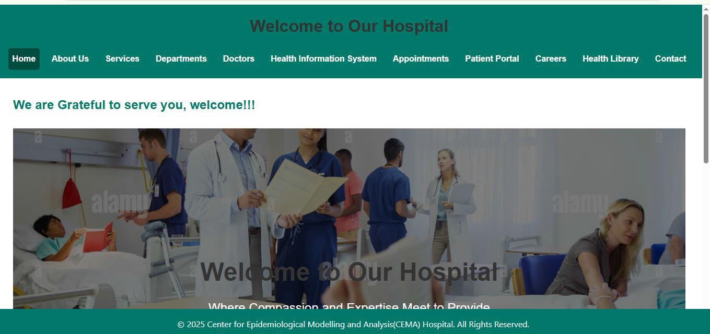
Enables integration with external systems.
JSON Response:
{
"id": 1,
"name": "John Doe", "age": 30,
"enrolled_programs": ["TB", "Malaria"]
}
PROTOTYPE DEMONSTRATION
Home Page

Slide 6
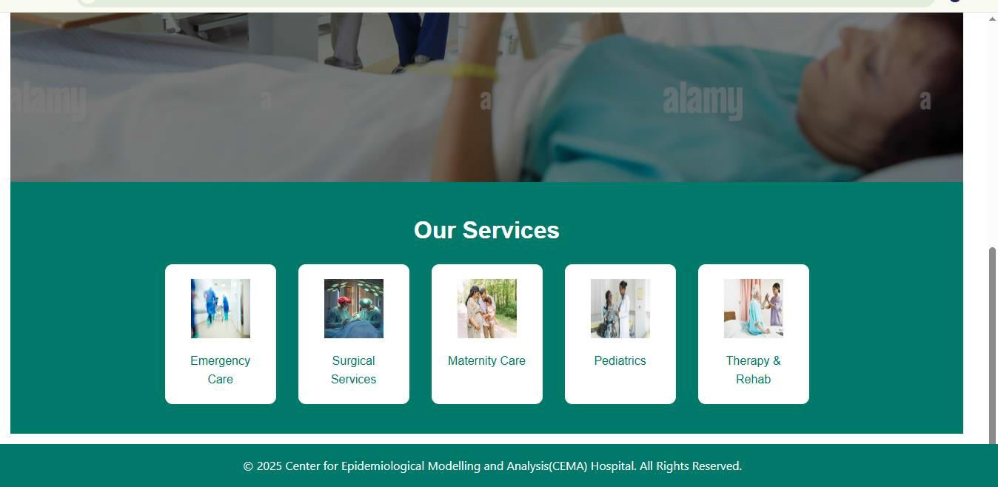
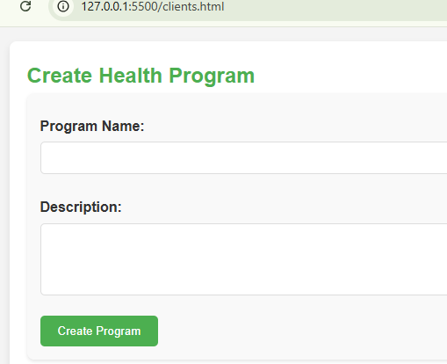
Program Creation
Client Registration

Slide 7
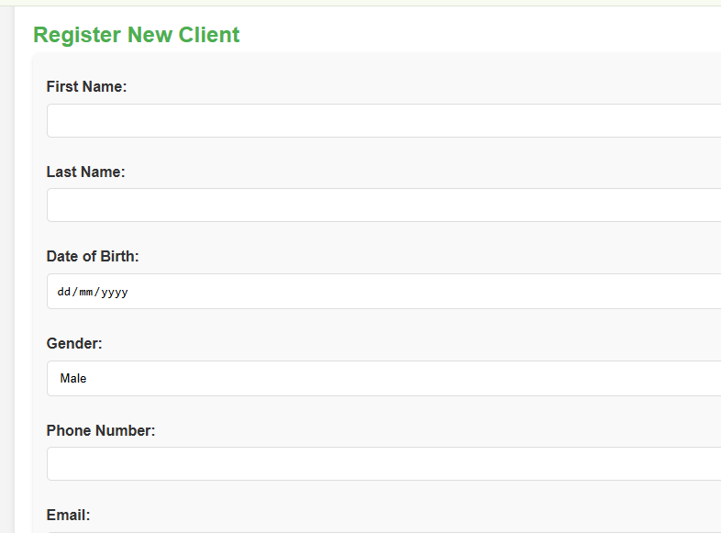
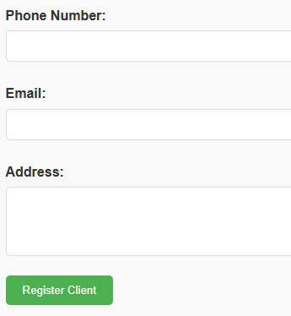

Slide 8
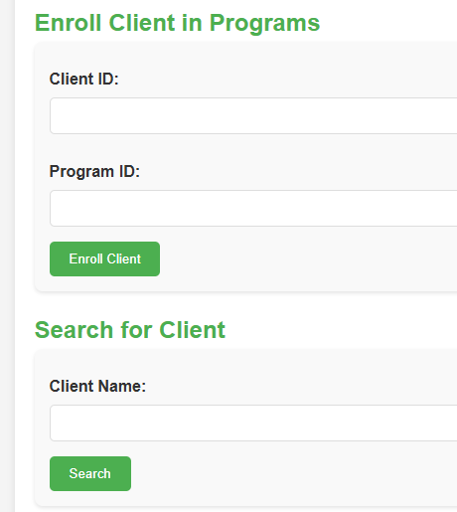
Enrollment and Viewing Profiles

Slide 9
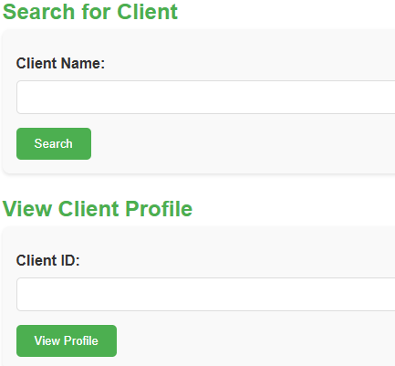
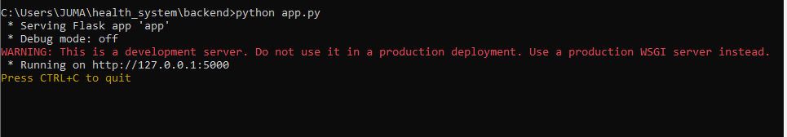
Backend running

Slide 10
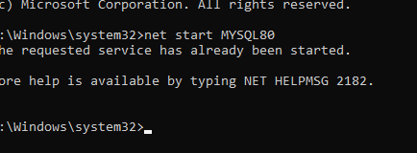
Database started to receive requests
Github Repository
Link: https://github.com/WENSLAUS002/health_information_system

